Slide 1

Fraud Prediction System in Financial Services
Olatunji Jaiyeola
May 2023

Slide 2
Contents
Background
Proposed solution
Model Development
Machine learning Algorithms
Key Findings
Evaluation

Slide 3
Background
The Problem statement
The increase in the use of technology has led to an increase in number fraud cases whose pattern are constantly changing and sophisticated.
Current Realities
£1.6 billion pounds was stopped in 2020(UK Finance, 2021).
Rule based systems are dependent on pre-defined set of criteria

Slide 4
Proposed Solution
Development of machine learning model trained with historical data
Benefits
High level of success in detecting fraud
Opportunity for cost reduction in fraud detection process
Adaptability of model

Slide 5
Model Development

Slide 6

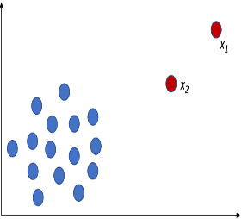

Data Pre-processing
Data cleaning
Outlier detection
Feature selection

Slide 7
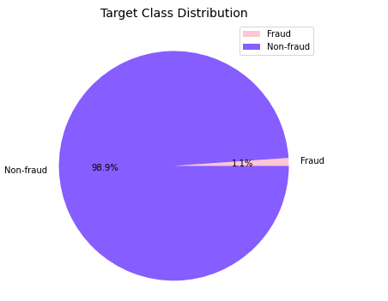
Target class
Techniques to address class imbalance
Synthetic Minority Over-sampling Technique (SMOTE)
Under-sampling
Fraud has 11029 cases
Non-Fraud has 988971 cases

Slide 8
Machine Learning Algorithms
Logistic Regression | Random Forest | K-Nearest Neighbors | Extreme Gradient Boosting
Used to examine the implication of predictor on an outcome that is categorical | Uses multiple decision trees to improve the accuracy of the prediction. | Finds the k closest data points in the feature space to the query point | Combines multiple weak classifiers, typically decision trees, to create a more accurate model.
Uses a sigmoid function to map input values to probability value that lies between 0 and 1. | Each decision tree in the forest predicts the target class by aggregating the predictions of all trees | It makes a prediction using the most common label among the k neighbors for classification tasks | Uses iteration to enhance the effectiveness by introducing new models that correct the errors of the previous ones
Simple and easy to interpret | Effective with high-dimensional dataset | Simple and flexible. | Fast and scalable

Slide 9

Key Finding
The payment modes used for fraudulent transactions are Internet and Teleapp
99% of fraud cases were done using Internet mode
There is positive correlation between fraud status and proposed credit limit

Slide 10
Evaluation
Evaluation
Under-Sampling
Algorithm | Precision | Recall | F1-Score
Logistic Regression | 0.8 | 0.79 | 0.8
KNN | 0.81 | 0.79 | 0.8
Random Forest | 0.92 | 0.84 | 0.88
Extreme Gradient Boosting | 0.92 | 0.88 | 0.9
Extreme Gradient Boosting | FAR | 0.07
Extreme Gradient Boosting | BCR | 0.9
SMOTE
Algorithm | Precision | Recall | F1-Score
Logistic Regression | 0.06 | 0.8 | 0.12
KNN | 0.14 | 0.61 | 0.8
Random Forest | 0.88 | 0.6 | 0.88
Extreme Gradient Boosting | 0.67 | 0.6 | 0.9
Extreme Gradient Boosting | FAR | 0.01
Extreme Gradient Boosting | BCR | 0.83

Slide 11
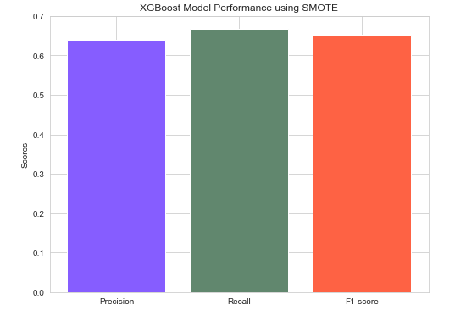
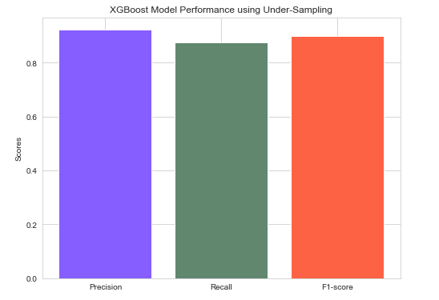
Evaluation

Slide 12
Conclusion
Ensemble classifier performed better than single classifier
Extreme gradient boost algorithm is best performing algorithm
Model has a BCR rate of 90% , this means can predict both classes well

Slide 13
Thank you
Questions?

Slide 14
References
ukfinance (2021). FRAUD -THE FACTS 2021 THE DEFINITIVE OVERVIEW OF PAYMENT INDUSTRY FRAUD. [online] Available at: https://www.ukfinance.org.uk/system/files/Fraud%20The%20Facts%202021-%20FINAL.pdf. [Accessed: 10 April 2023]
Shokrzade, A., Ramezani, M., Akhlaghian T, F. and Abdulla Mohammad, M. (2021). A novel extreme learning machine based kNN classification method for dealing with big data. Expert Systems with Applications, Available at: https://doi.org/10.1016/j.eswa.2021.115293. [Accessed: 10 April 2023]
Nick, T.G. and Campbell, K.M. (2007). Logistic Regression. Topics in Biostatistics, pp.273–301. Available at: https://doi.org/10.1007/978-1-59745-530-5_14. [Accessed:13 March. 2023]

